Slide 1
Summary of measurable quantities
Name | Symbol | Dimension (SI unit) | Definition | Comment
Isothermal Joule-Thomson coefficient | $$μ_{T}$$ | Volume ($m^{3}$) | $${\left(\frac{∂H}{∂P}\right)}_{T}$$ | $$μ_{T}=−C_{P}μ_{JT}$$
Adiabatic Joule-Thomson coefficient | $$μ_{JT}$$ | Temp/Pressure $\left(\frac{K}{Pa}\right)$ | $${\left(\frac{∂T}{∂P}\right)}_{H}$$ | Measured in the Joule- Thomson experiment
Isothermal Joule coefficient (aka internal pressure) | $$π_{T}$$ | Pressure ($Pa$) | $${\left(\frac{∂U}{∂V}\right)}_{T}$$ | Measured in the Joule experiment
Isobaric heat capacity | $$C_{P}$$ | Energy/Temp ($J/K$) | $${\left(\frac{∂H}{∂T}\right)}_{P}$$ | Measure, or approximate as $$C_{V}+nR$$
Isochoric heat capacity | $$C_{V}$$ | Energy/Temp ($J/K$) | $${\left(\frac{∂U}{∂T}\right)}_{V}$$ | Est. from equipartition, or approximate as $$C_{P}−nR$$
Isothermal compressibility | $κ_{T}$ | 1/Pressure (${Pa}^{−1}$) | $$−\frac{1}{V}{\left(\frac{∂V}{∂P}\right)}_{T}$$ | Water density at the ocean floor
Isobaric thermal expansivity | $α_{P}$ | 1/Temp ($K^{−1}$) | $$\frac{1}{V}{\left(\frac{∂V}{∂T}\right)}_{P}$$ | Sea level rise
Expansivity-to-compressibility ratio | $$α_{P}/κ_{T}$$ | Pressure/Temp ($Pa/K$) | $${\left(\frac{∂P}{∂T}\right)}_{V}$$ | From Euler chain relation
Boyle temperature | $$T_{Boyle}$$ | Temp ($K$) | Temp at which $$P_{real}=P_{ideal}$$ | vdw: $\frac{a}{Rb}$
Inversion temperature | $$T_{inv}$$ | Temp ($K$) | Temp at which $$μ_{T}=0$$ | vdw: $\frac{2a}{Rb}$
Critical temperature | $$T_{crit}$$ | Temp ($K$) | Temp at which $${\left(\frac{∂P}{∂V}\right)}_{T}={\left(\frac{∂^{2}P}{∂V^{2}}\right)}_{T}=0$$ | vdw: $\frac{8a}{27Rb}≈\frac{a}{3Rb}$

Slide 2
Week 10 – Thermodynamic Definition of Entropy (TDE)
We don’t have an entropy-meter. However, the Thermodynamic Definition of Entropy (TDE) can help:
$dS=\frac{dq_{rev}}{T}$
Embedded in the TDE:
Adding heat to an object means $dq_{rev}>0$, so its entropy goes up.
Removing heat from an object means $dq_{rev}<0$, so its entropy goes down.
Adding heat to a cold object will raise its entropy more than adding the same amount of heat to an object that’s already hot.

Slide 3
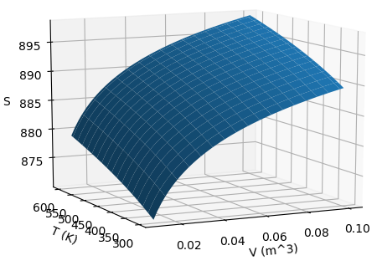
Week 10 – $S(T,V)$as a thermodynamic surface
$${\left(\frac{∂S}{∂T}\right)}_{V}$$
$${\left(\frac{∂S}{∂V}\right)}_{T}$$
Temperature
Volume
$$dS=\frac{C_{V}}{T}dT+\frac{α_{P}}{κ_{T}}dV$$

Slide 4

The kind of question I might ask – About $S(T,V)$
$S(T,V)$ for a gas
Which arrow is accompanied by a change in positional entropy (and why)?

Slide 5
The kind of question I might ask – About $S(T,V)$
$S(T,V)$ for a gas
Which arrow is accompanied by a change in positional entropy (and why)?

Slide 6
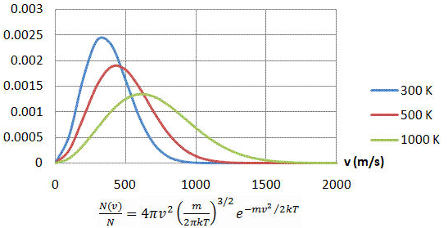

The kind of question I might ask – About $S(T,V)$
For a given volume of gas, which probability density corresponds to higher thermal entropy?
Probability density of molecular speeds

Slide 7
The kind of question I might ask – About $S(T,V)$
For a given volume of gas, which probability density corresponds to higher thermal entropy?
Probability density of molecular speeds

Slide 8
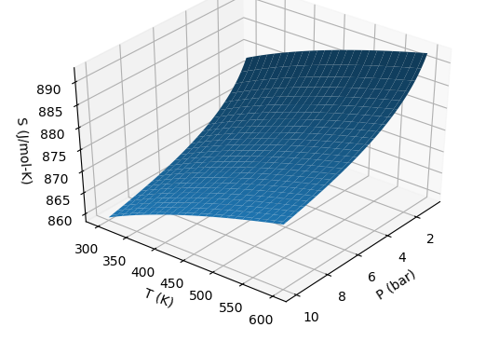
Week 10 – $S(T,P)$as a thermodynamic surface
$${\left(\frac{∂S}{∂P}\right)}_{T}$$
← Pressure
$${\left(\frac{∂S}{∂T}\right)}_{P}$$
Temperature
$$dS=\frac{C_{P}}{T}dT−α_{P}VdP$$

Slide 9
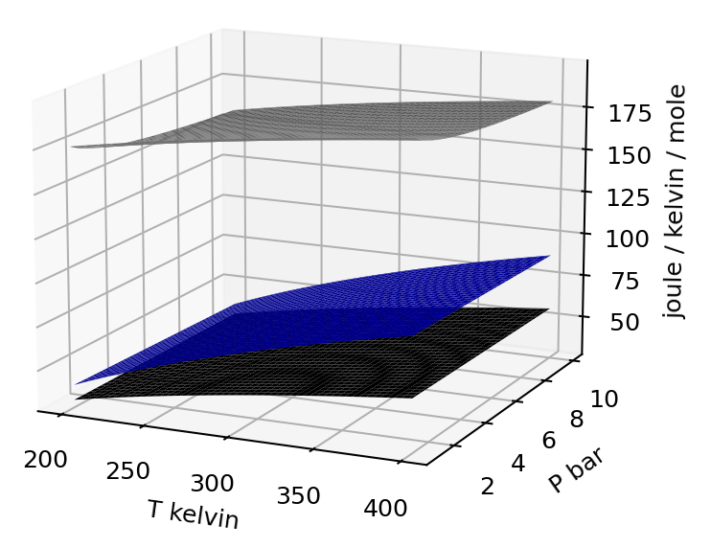
The kind of question I might ask – Distinguishing between entropy of different phases
$$S(T,P)$$
These surfaces represent solid, liquid, and gas.
Which is which?

Slide 10
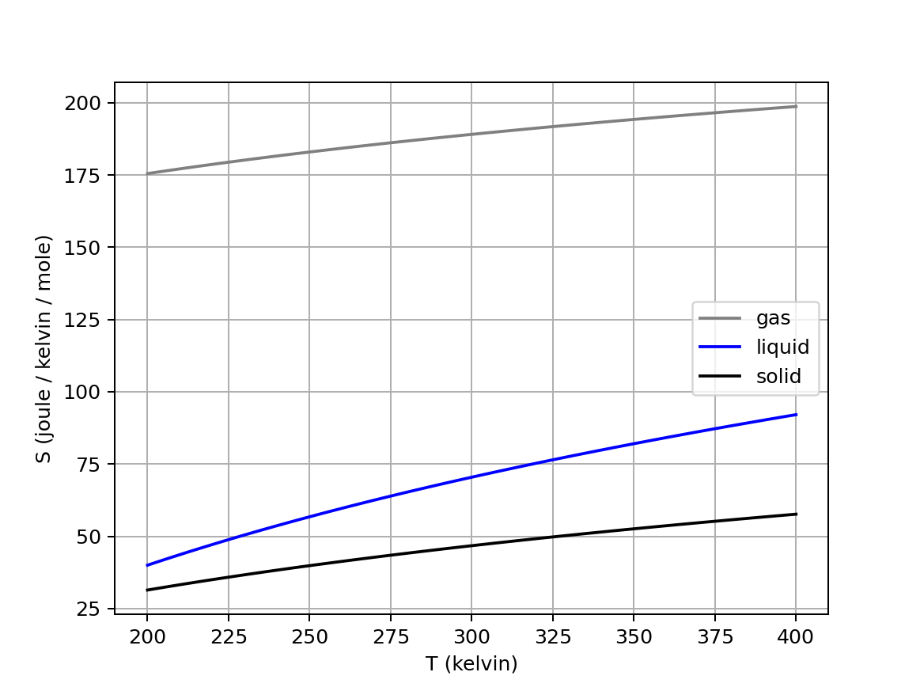
Week 10 – Entropy of phase transitions at their normal transition temperatures
Here’s $∆S_{vap}$ of water at its normal boiling temperature, and $∆S_{fus}$at the normal melting temperature of water.

Slide 11
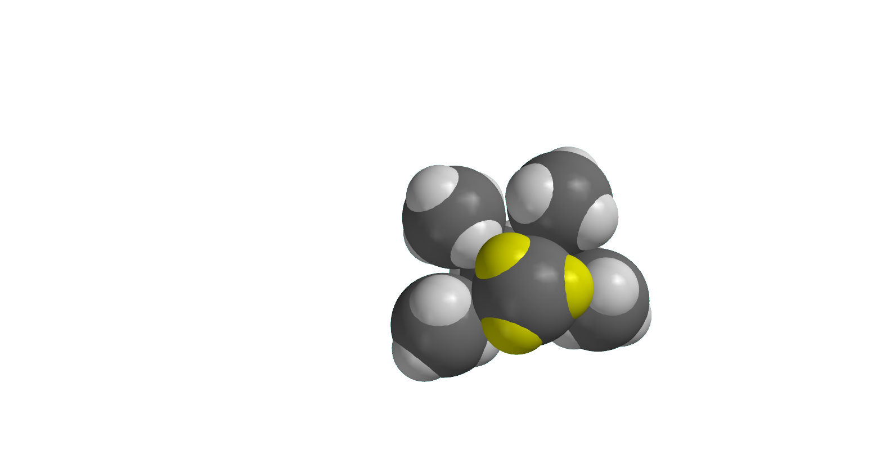
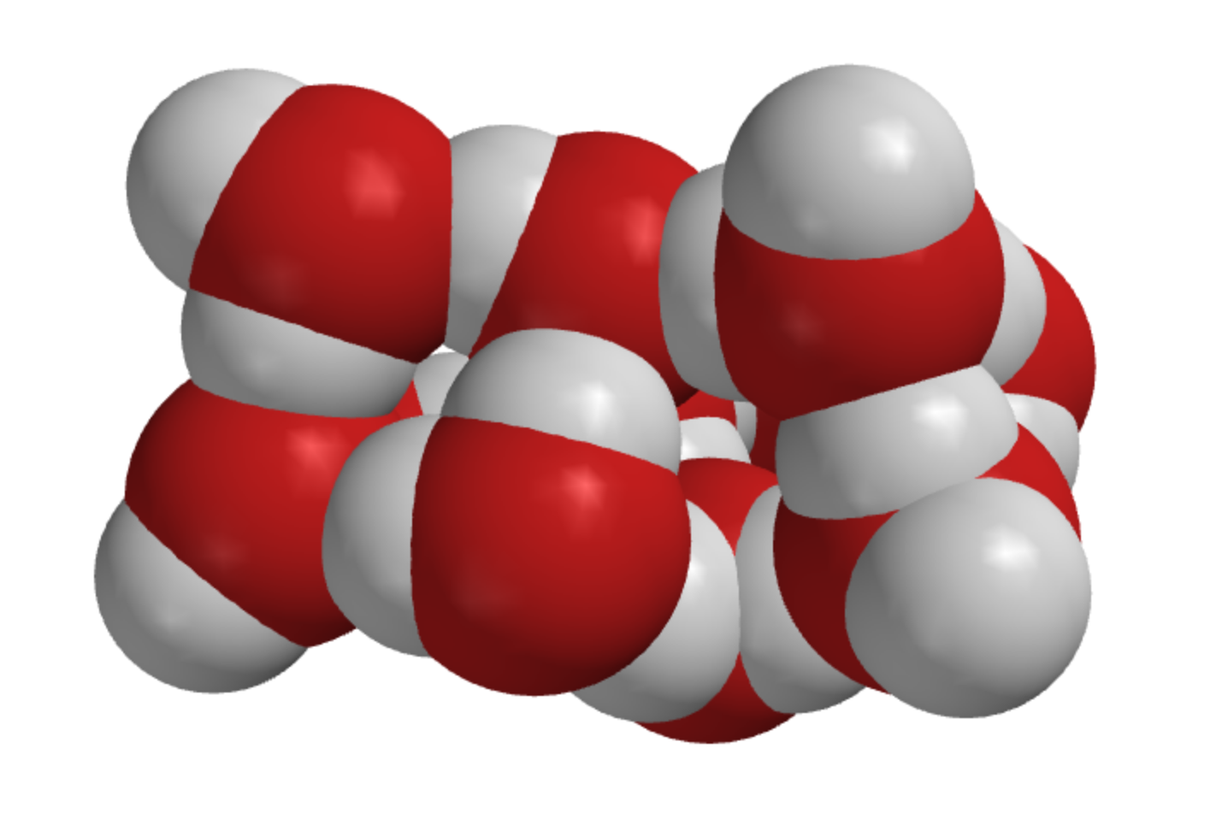
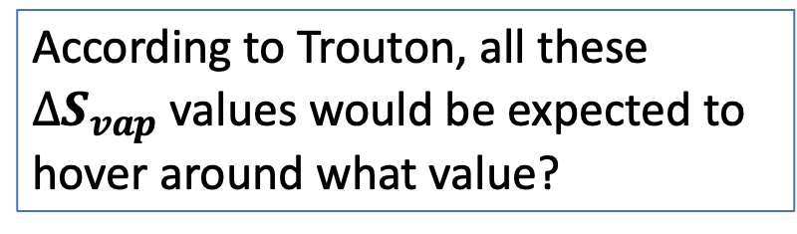
The kind of question I might ask – About $∆S_{vap}$
According to Trouton, all these $∆S_{vap}$ values would be expected to hover around what value?
Methane
Acetone
Water
Notes:
https://slideplayer.com/slide/7362502/

Slide 12
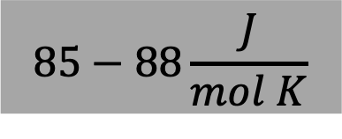
The kind of question I might ask – About $∆S_{vap}$
According to Trouton, all these $∆S_{vap}$ values would be expected to hover around what value?
Methane
Acetone
$$85−88\frac{J}{mol K}$$
Water
Notes:
https://slideplayer.com/slide/7362502/

Slide 13
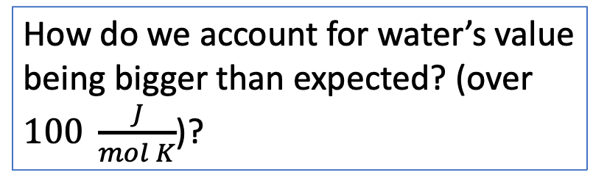
The kind of question I might ask – About $∆S_{vap}$
According to Trouton, all these $∆S_{vap}$ values would be expected to hover around what value?
Methane
Acetone
$$85−88\frac{J}{mol K}$$
Water
How do we account for water’s value being bigger than expected? (over $100 \frac{J}{mol K}$)?
Notes:
https://slideplayer.com/slide/7362502/

Slide 14
Week 11 – The two parts of the 2nd Law
The 2nd Law divides the question of spontaneity into two parts:
A system part that we can get at using differential equations of state for the entropy, and thermodynamic tables of entropy
A surroundings part that deals with the entropy change of the surroundings due to heat transfer, that we can get at using thermodynamic tables of enthalpy

Slide 15
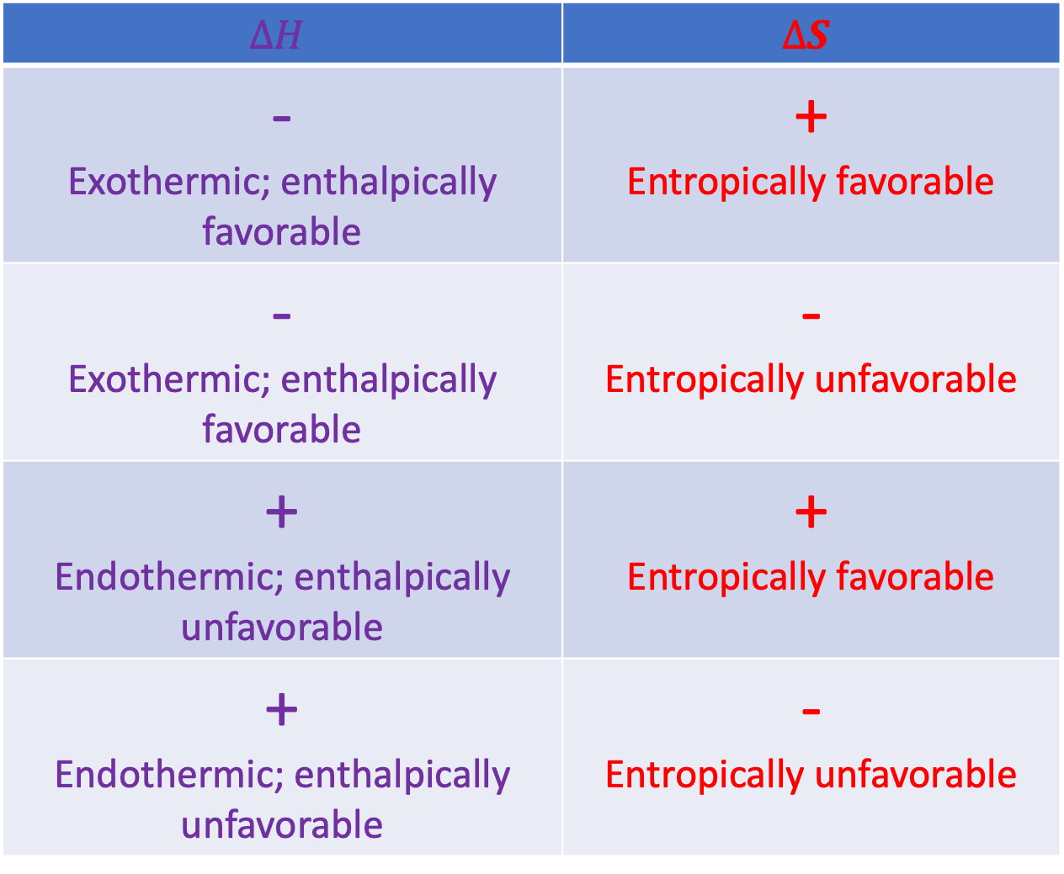
Week 11 – Systematizing the enthalpic/entropic favorability/unfavorability picture
$$∆H$$ | $$∆S$$
- Exothermic; enthalpically favorable | + Entropically favorable
- Exothermic; enthalpically favorable | - Entropically unfavorable
+ Endothermic; enthalpically unfavorable | + Entropically favorable
+ Endothermic; enthalpically unfavorable | - Entropically unfavorable

Slide 16
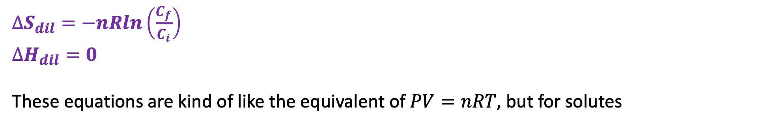
Week 11 – Entropy (and enthalpy) of dilution
$∆S_{dil}=−nRln\left(\frac{C_{f}}{C_{i}}\right)$
$∆H_{dil}=0$
These equations are kind of like the equivalent of $PV=nRT$, but for solutes

Slide 17
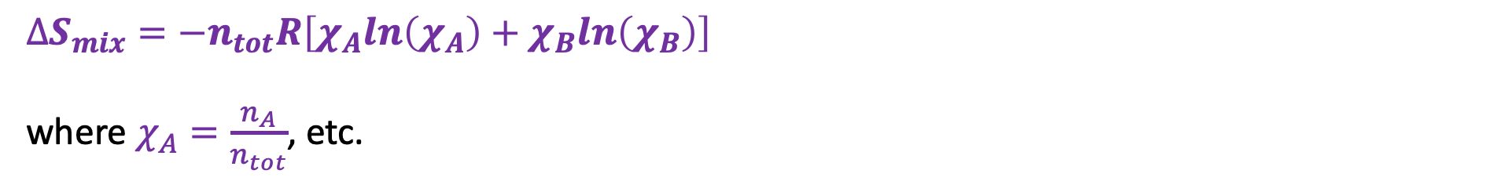

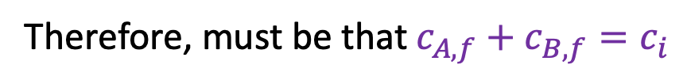



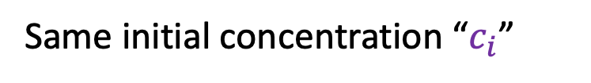
Week 11 – Entropy of mixing – the E-ICE equation
$$n_{A}$$
$$c_{B,f}$$
$$n_{B}$$
$$c_{A,f}$$
Same initial concentration “$c_{i}$”
Therefore, must be that $c_{A,f}+c_{B,f}=c_{i}$
$∆S_{mix}=−n_{tot}R\left[χ_{A}ln\left(χ_{A}\right)+χ_{B}ln\left(χ_{B}\right)\right]$
where $χ_{A}=\frac{n_{A}}{n_{tot}}$, etc.

Slide 18
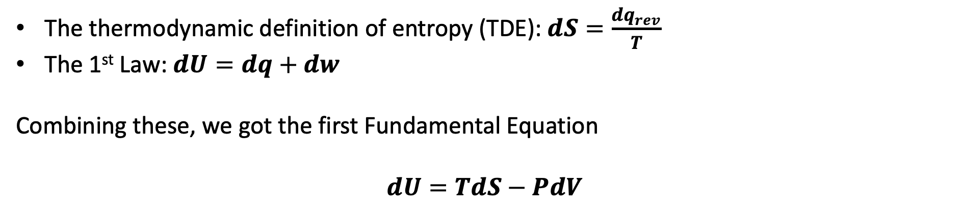
Week 11 – How the “Fundamental Equations” came about
The thermodynamic definition of entropy (TDE): $dS=\frac{dq_{rev}}{T}$
The 1st Law: $dU=dq+dw$
Combining these, we got the first Fundamental Equation
$$dU=TdS−PdV$$

Slide 19
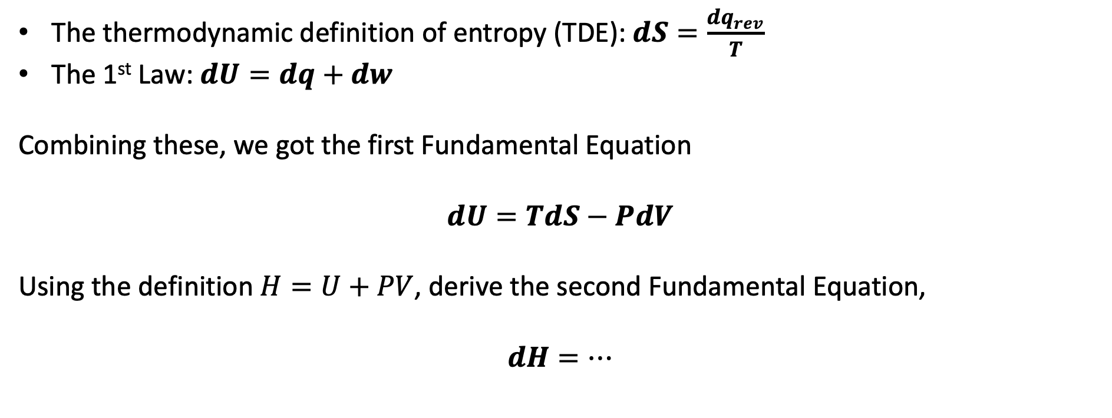
The kind of question I might ask – The other three fundamental equations
The thermodynamic definition of entropy (TDE): $dS=\frac{dq_{rev}}{T}$
The 1st Law: $dU=dq+dw$
Combining these, we got the first Fundamental Equation
$$dU=TdS−PdV$$
Using the definition $H=U+PV$, derive the second Fundamental Equation,
$$dH=…$$

Slide 20
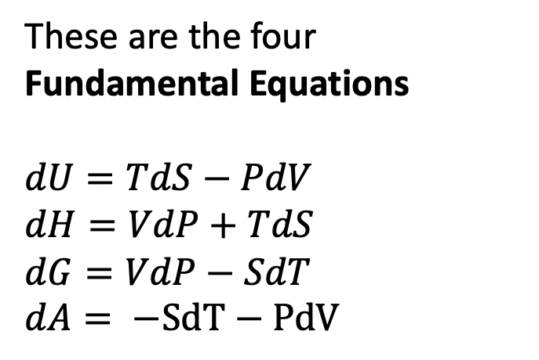
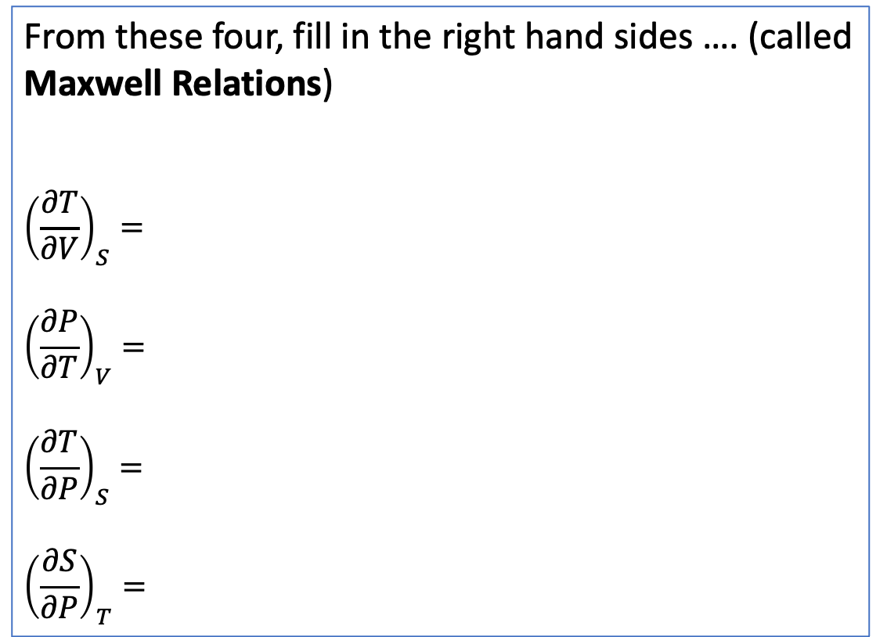
The kind of question I might ask – Maxwell Relations
From these four, fill in the right hand sides …. (called Maxwell Relations)
$${\left(\frac{∂T}{∂V}\right)}_{S}=$$
$${\left(\frac{∂P}{∂T}\right)}_{V}=$$
$${\left(\frac{∂T}{∂P}\right)}_{S}=$$
$${\left(\frac{∂S}{∂P}\right)}_{T}=$$
These are the four Fundamental Equations
$dU=TdS−PdV$
$dH=VdP+TdS$
$dG=VdP−SdT$
$dA= −SdT−PdV$

Slide 21
The kind of question I might ask – Maxwell Relations
From these four, fill in the right hand sides …. (called Maxwell Relations)
$${\left(\frac{∂T}{∂V}\right)}_{S}=$$
$${\left(\frac{∂P}{∂T}\right)}_{V}=$$
$${\left(\frac{∂T}{∂P}\right)}_{S}=$$
$${\left(\frac{∂S}{∂P}\right)}_{T}=$$
These are the four Fundamental Equations
$dU=TdS−PdV$
$dH=VdP+TdS$
$dG=VdP−SdT$
$dA= −SdT−PdV$
Cross-derivative rule

Slide 22

The kind of question I might ask – Maxwell Relations
From these four, fill in the right hand sides …. (called Maxwell Relations)
$${\left(\frac{∂T}{∂V}\right)}_{S}=$$
${\left(\frac{∂P}{∂T}\right)}_{V}=$ ${\left(\frac{∂S}{∂V}\right)}_{T}$
$${\left(\frac{∂T}{∂P}\right)}_{S}=$$
$${\left(\frac{∂S}{∂P}\right)}_{T}=$$
These are the four Fundamental Equations
$dU=TdS−PdV$
$dH=VdP+TdS$
$dG=VdP−SdT$
$dA= −SdT−PdV$

Slide 23
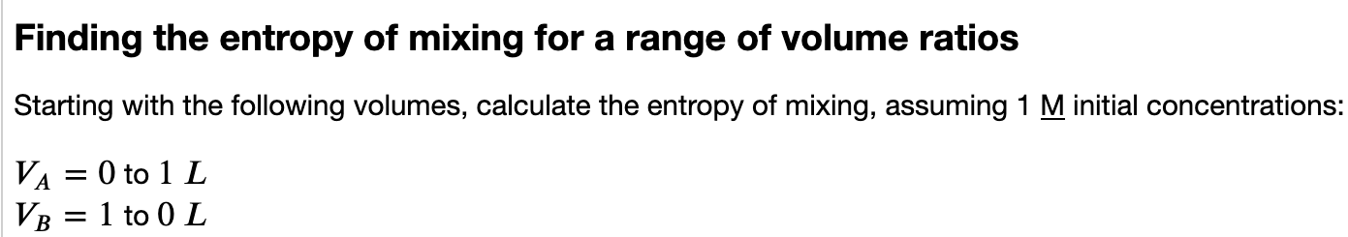
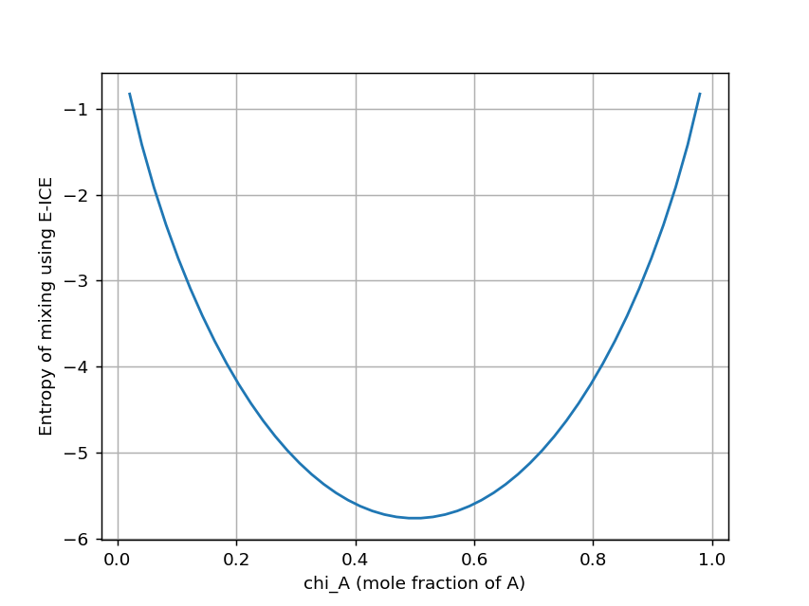
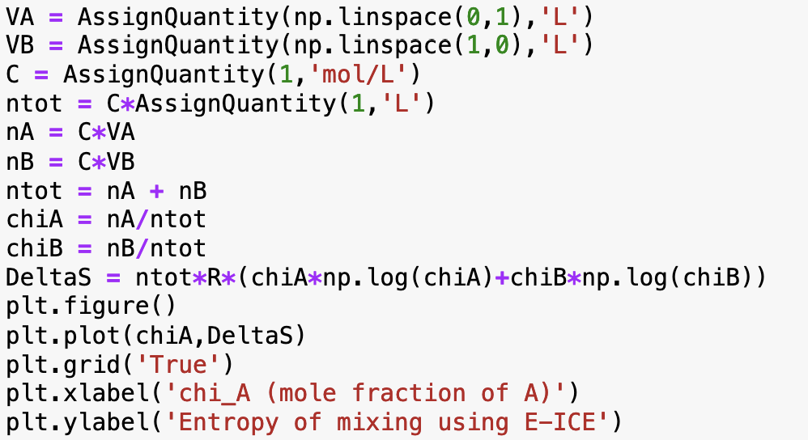
The kind of question I might ask – Calculating the entropy of mixing
Something is dreadfully wrong here … what?

Slide 24
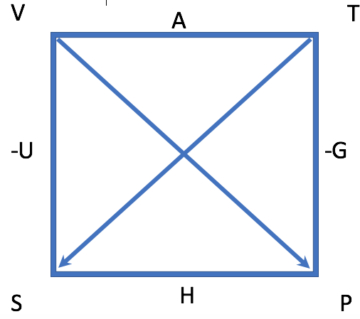
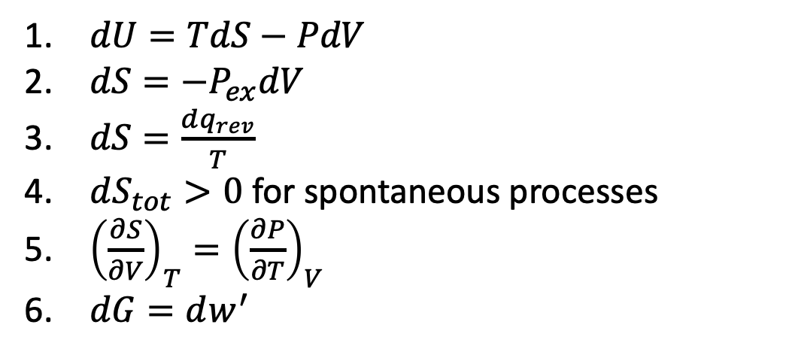
The kind of question I might ask – How entropy is related to other thermodynamic quantities
$dU=TdS−PdV$
$dS=−P_{ex}dV$
$dS=\frac{dq_{rev}}{T}$
$dS_{tot}>0$ for spontaneous processes
${\left(\frac{∂S}{∂V}\right)}_{T}={\left(\frac{∂P}{∂T}\right)}_{V}$
$dG=dw^{′}$
Which equation number would you associate with each of these?
The Thermodynamic Definition of Entropy
The 2nd Law of Thermodynamics
One of the four fundamental differential equations of Thermodynamics
A Maxwell relation

